Slide 1
NBA: Bayesian Skill Ranking
Leland Chen, Joseph Huang, Ryan Thompson

Slide 2
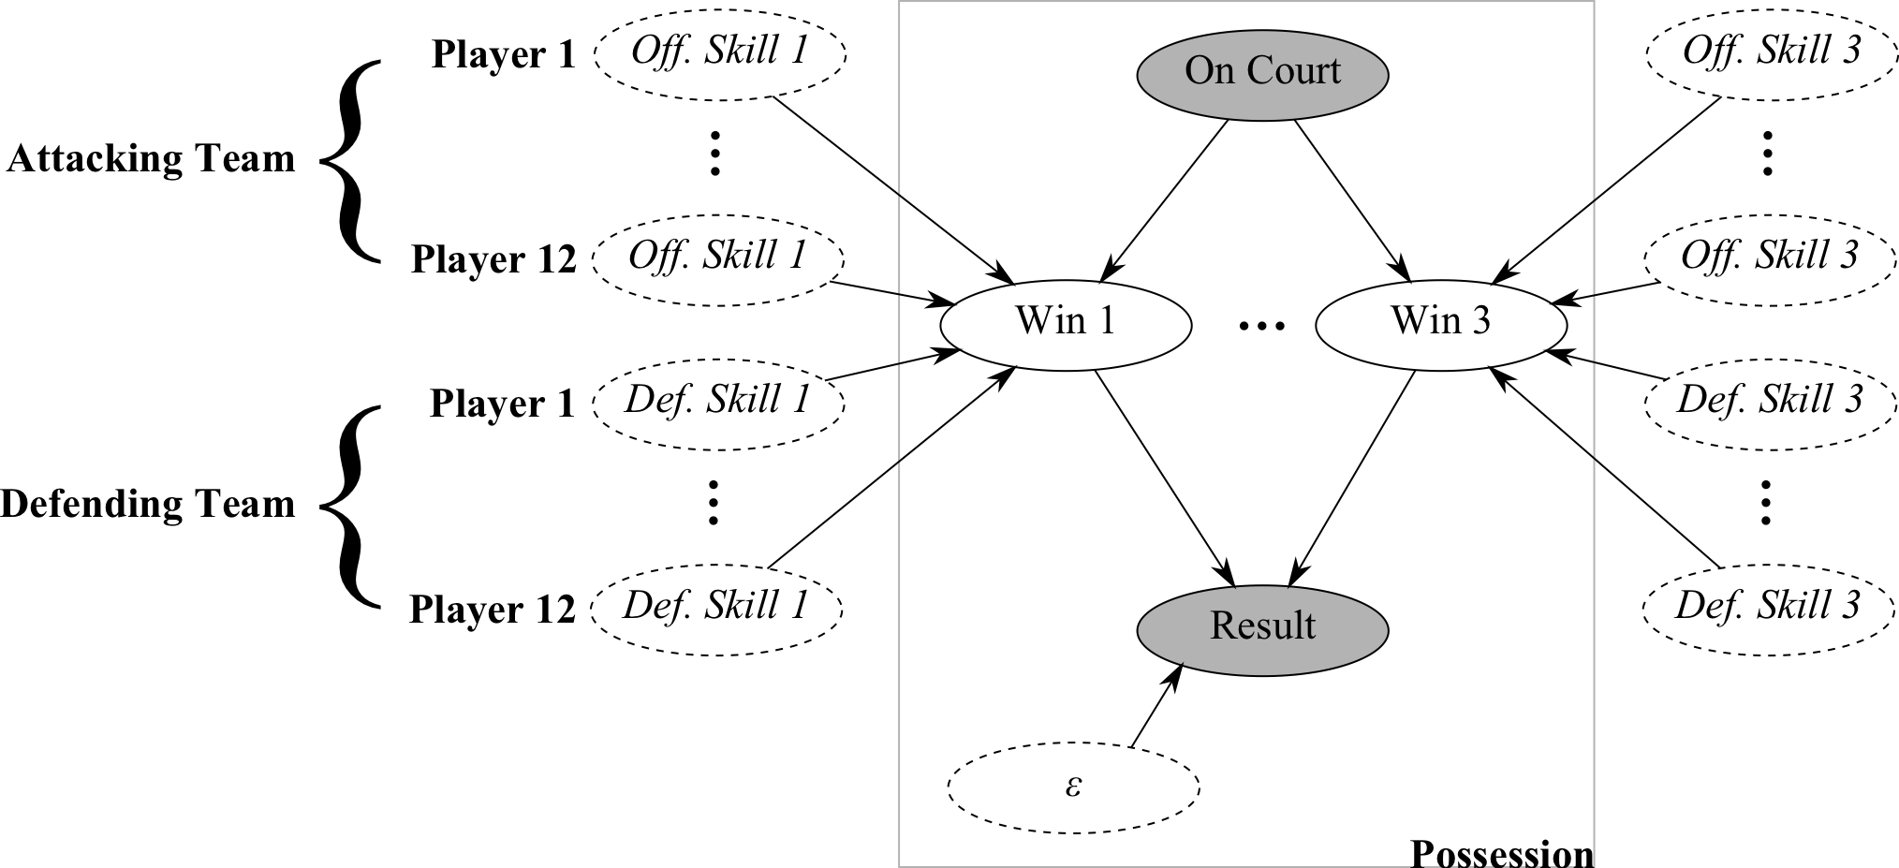
Proposed Network

Slide 3
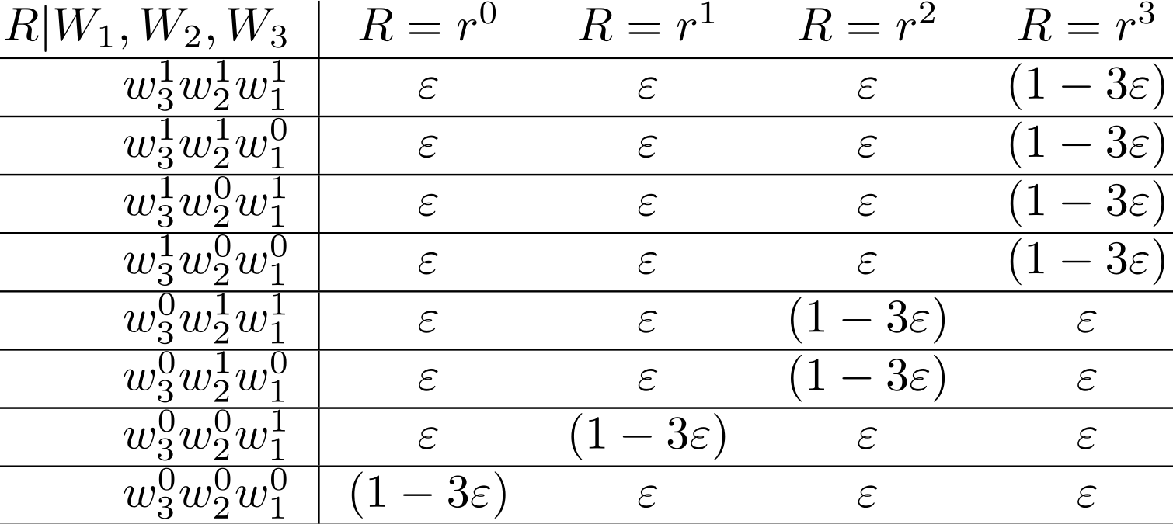

Slide 4
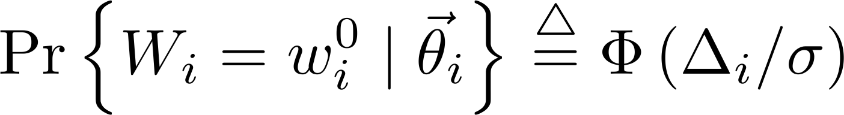
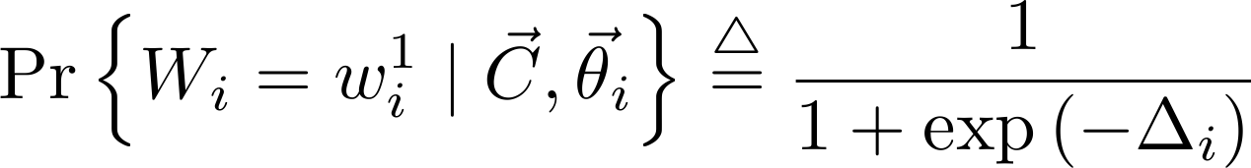
Gaussian
Logistic

Slide 5
Case Study: One Game
Offensive/Defensive Skills
 | Off. 1 pt | Off. 2 pt | Off. 3 pt | Def. 1 pt | Def. 2 pt | Def. 3 pt
Zydrunas Ilgauskas | -52.282 | 9.000 | 34.708 | 16.104 | 18.088 | 7.638
Offensive Skills: Higher the better
Defensive Skills: Lower the better
1 complete game; 183 total possessions
Traditional Box Score
 | FGM-A | 3GM-A | FTM-A | OFF-DEF-TOT | +/- | STL | BLK | PTS
Zydrunas Ilgauskas | 7-11 | 0-0 | 0-0 | 4-6-10 | +2 | 1 | 1 | 14
CLE @ DET, March 07, 2007. 101-97 OT.

Slide 6
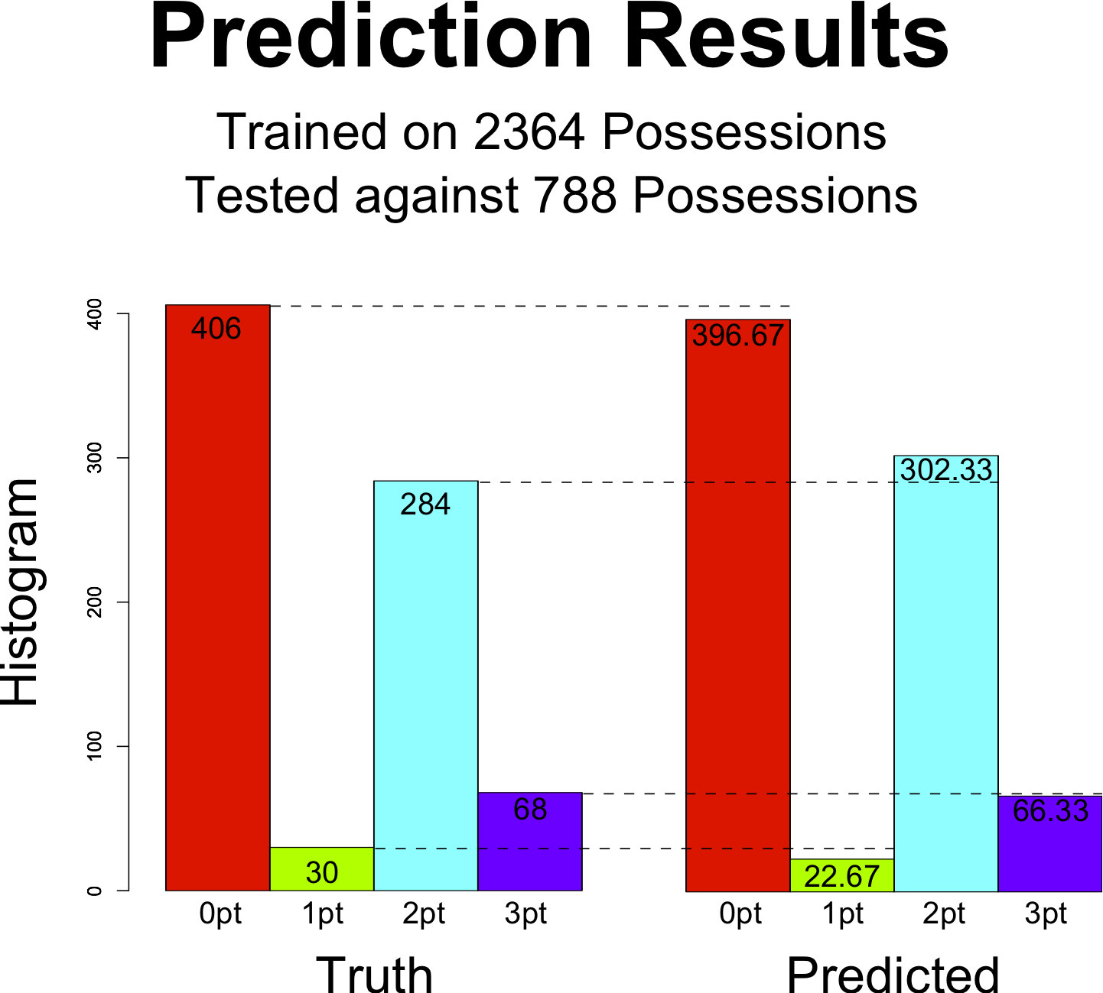
Southwest Division 2008-2009
Offensive Skills: Higher the better
Defensive Skills: Lower the better
2 pt Off./Def. Players
(600+ possessions)
35 games; 3152 1st half possessions*
Off. 2 pt | Def. 2 pt | Player
0.478 | -0.528 | Jason Terry
0.620 | -0.270 | Yao Ming
0.391 | -0.179 | Luis Scola
-0.029 | -0.029 | League Avg.
-0.480 | 0.033 | Ron Artest
-0.195 | 0.452 | Rasual Butler
-0.482 | 0.398 | Dirk Nowitzki

Slide 7
Case Study: Dallas Mavericks
Offensive/Defensive Skills
 | Off. 1 pt | Off. 2 pt | Off. 3 pt | Def. 1 pt | Def. 2 pt | Def. 3 pt
Jason Terry | -527.858 | 0.478 | -1.836 | 180.376 | -0.528 | 12.050
Jason Kidd | -55.968 | 0.205 | -2.996 | 64.236 | -0.261 | 10.115
Dirk Nowitzki | 466.984 | -0.482 | 0.353 | 105.667 | 0.398 | -6.913
League Avg. | -0.197 | -0.029 | -0.137 | -0.197 | -0.029 | -0.137
Offensive Skills: Higher the better
Defensive Skills: Lower the better
35 games; 3152 1st half possessions*

Slide 8
Future Work
Conclusion
Smoothing/Bayesian Prior
Coach Skill
Even More Data
New way to rank players based on individual contributions

